Slide 1
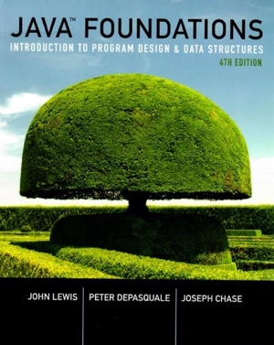
Chapter 2
Data and Expressions

Slide 2
Chapter Scope
Character strings and concatenation
Escape sequences
Declaring and using variables
Java primitive types
Expressions
Data conversions
The Scanner class for interactive programs

Slide 3
Character Strings
A string of characters can be represented as a string literal by putting double quotes around it
Examples:
"This is a string literal."
"123 Main Street"
"X"
Every character string is an object in Java, defined by the String class
Every string literal represents a String object

Slide 4
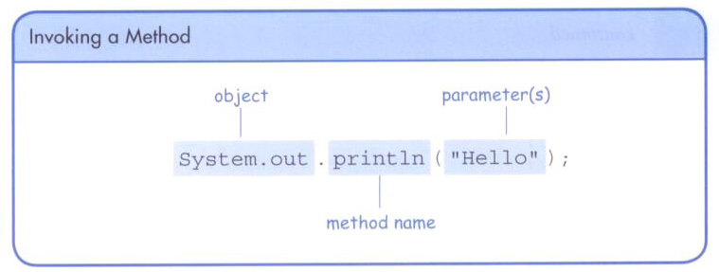
The println Method
In HelloWorld & Lincoln examples, the println() method displayed a character string
System object refers to the operating system, and out object refers the OS’s standard output (monitor, console), and out’s println() method

Slide 5
The print Method
The System.out object provides another service as well
The print() method is similar to the println() method, except that it does not advance to the next line
Therefore anything printed after a print statement will appear on the same line

Slide 6
//********************************************************************
// Countdown.java Java Foundations
//
// Demonstrates the difference between print and println.
//********************************************************************
public class Countdown
{
//-----------------------------------------------------------------
// Prints two lines of output representing a rocket countdown.
//-----------------------------------------------------------------
public static void main(String[] args)
{
System.out.print("Three... ");
System.out.print("Two... ");
System.out.print("One... ");
System.out.print("Zero... ");
System.out.println("Liftoff!"); // appears on first output line
System.out.println("Houston, we have a problem.");
}
}

Slide 7
String Concatenation
The string concatenation operator (+) is used to append one string to the end of another
"Peanut butter " + "and jelly"
It can also be used to append a number to a string
A string literal cannot be broken across two lines in a program

Slide 8
//********************************************************************
// Facts.java Java Foundations
//
// Demonstrates the use of the string concatenation operator and the
// automatic conversion of an integer to a string.
//********************************************************************
public class Facts
{
//-----------------------------------------------------------------
// Prints various facts.
//-----------------------------------------------------------------
public static void main(String[] args)
{
// Strings can be concatenated into one long string
System.out.println("We present the following facts for your "
+ "extracurricular edification:");
System.out.println();
// A string can contain numeric digits
System.out.println("Letters in the Hawaiian alphabet: 12");
// A numeric value can be concatenated to a string
System.out.println("Dialing code for Antarctica: " + 672);
System.out.println("Year in which Leonardo da Vinci invented "
+ "the parachute: " + 1515);
System.out.println("Speed of ketchup: " + 40 + " km per year");
}
}

Slide 9
String Concatenation
The + operator is also used for arithmetic addition
The function that it performs depends on the type of the information on which it operates
If both operands are strings, or if one is a string and one is a number, it performs string concatenation
If both operands are numeric, it adds them
+ operator is evaluated left to right, and parentheses can force the order (same rule as in Math)

Slide 10
//********************************************************************
// Addition.java Java Foundations
//
// Demonstrates the difference between the addition and string
// concatenation operators.
//********************************************************************
public class Addition
{
//-----------------------------------------------------------------
// Concatenates and adds two numbers and prints the results.
//-----------------------------------------------------------------
public static void main(String[] args)
{
System.out.println("24 and 45 concatenated: " + 24 + 45);
System.out.println("24 and 45 added: " + (24 + 45));
}
}
What do you think happens in these examples?
System.out.println ( 3 + “ is the number.” );
System.out.println ( 3 + 4 + “ is the number.” );

Slide 11
Escape Sequences
What if we wanted to print a the single or double quote characters? ' "
The following line would confuse the compiler because it would interpret the second quote as the end of the string
System.out.println("I said "Hello" to you.");
An escape sequence is a series of characters that together represents a special, single character
An escape sequence begins with a backslash character (\)
System.out.println("I said \"Hello\" to you.");

Slide 12
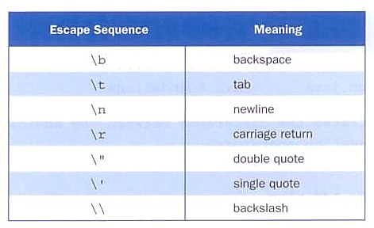
Escape Sequences
Some Java escape sequences:

Slide 13
//********************************************************************
// Roses.java Java Foundations
//
// Demonstrates the use of escape sequences.
//********************************************************************
public class Roses
{
//-----------------------------------------------------------------
// Prints a poem (of sorts) on multiple lines.
//-----------------------------------------------------------------
public static void main(String[] args)
{
System.out.println("Roses are red,\n\tViolets are blue,\n" +
"Sugar is sweet,\n\tBut I have \"commitment issues\",\n\t" +
"So I'd rather just be friends\n\tAt this point in our " +
"relationship.");
}
}

Slide 14
Variables
A variable is a name for a location in memory
A variable must be declared by specifying its name and the type of information that it will hold
data type
variable name
int total;
int count, temp, result;
Multiple variables can be created in one declaration

Slide 15
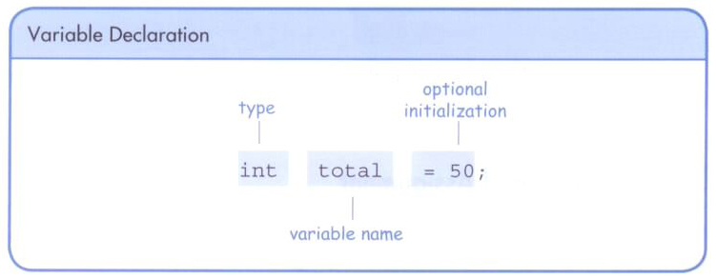
Variables
A variable can be given an initial value in the declaration
When a variable is referenced in a program statement, the current value at that moment is used

Slide 16
//********************************************************************
// PianoKeys.java Java Foundations
//
// Demonstrates the declaration, initialization, and use of an
// integer variable.
//********************************************************************
public class PianoKeys
{
//-----------------------------------------------------------------
// Prints the number of keys on a piano.
//-----------------------------------------------------------------
public static void main(String[] args)
{
int keys = 88;
System.out.println("A piano has " + keys + " keys.");
}
}

Slide 17
Assignment
An assignment statement changes the value of a variable
The assignment operator is the = sign
store the value of 55 to the memory location identified as total
The expression on the right is evaluated and the result is stored in the variable on the left
The value that was in total is overwritten
Only a value consistent with the variable’s datatype can be assigned
total = 55;

Slide 18
//********************************************************************
// Geometry.java Java Foundations
//
// Demonstrates the use of an assignment statement to change the
// value stored in a variable.
//********************************************************************
public class Geometry
{
//-----------------------------------------------------------------
// Prints the number of sides of several geometric shapes.
//-----------------------------------------------------------------
public static void main(String[] args)
{
int sides = 7; // declaration with initialization
System.out.println("A heptagon has " + sides + " sides.");
sides = 10; // assignment statement
System.out.println("A decagon has " + sides + " sides.");
sides = 12;
System.out.println("A dodecagon has " + sides + " sides.");
}
}

Slide 19
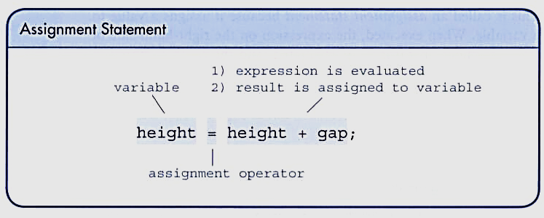
Assignment
The right-hand side could be an expression
The expression is completely evaluated and the result is stored in the variable

Slide 20
Constants
A constant is an identifier that is similar to a variable except that it holds the same value during its entire existence
As the name implies, it is constant, not variable
The compiler will issue an error if you try to change the value of a constant
In Java, we use the final modifier to declare a constant
final int MIN_HEIGHT = 69;

Slide 21
Constants
Constants are useful for three important reasons
First, they give meaning to otherwise unclear literal values
For example, MAX_LOAD means more than the literal 250
Second, they facilitate program maintenance
If a constant is used in multiple places, its value need only be updated in one place
Third, they formally establish that a value should not change, avoiding inadvertent errors by other programmers

Slide 22
Primitive Data Types
There are eight primitive data types in Java
Four of them represent integers
byte, short, int, long
Two of them represent floating point numbers
float, double
One of them represents characters
char
And one of them represents boolean values
boolean
…but don’t forget about the “hidden” type (aka: pointer)
Memory Address (often 4 bytes)

Slide 23
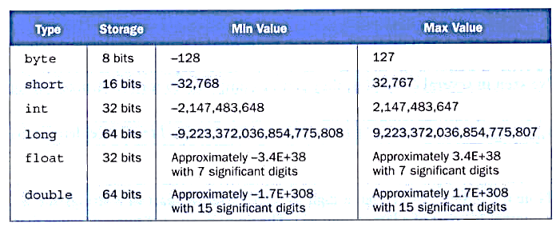
Numeric Types
The difference between the various numeric primitive types is their size, and therefore the range of values they can store:
Note: a bit: single 0,1 a byte: 8 bits

Slide 24
Characters
A char variable stores a single character
The char datatype is 16 bits (2 bytes)
Character literals are delimited by single quotes:
'a' 'X' '7' '$' ',' '\n'
Example declarations
char topGrade = 'A';
char terminator = ';', separator = ' ';
Note the distinction between a primitive character variable, which holds only one character, and a String object, which can hold multiple characters

Slide 25
Character Sets
A character set is an ordered list of characters, with each character corresponding to a unique number
A char variable in Java can store any character from the Unicode character set
The Unicode character set uses sixteen bits per character
It is an international character set, containing symbols and characters from many world languages

Slide 26
Characters
The ASCII character set is older and smaller than Unicode
The ASCII characters are a subset of the Unicode character set, including:
uppercase letters
lowercase letters
punctuation
digits
special symbols
control characters
A, B, C, …
a, b, c, …
period, semi-colon, …
0, 1, 2, …
&, |, \, …
carriage return, tab, ...

Slide 27
Booleans
A boolean value represents true or false - The boolean datatype is 1 bit (but really 1 byte) because the computer’s memory lines up in bytes
The reserved words true and false are the only valid values for a boolean type
boolean done = false;
A boolean variable can also be used to represent concepts of things that have two states, such as a light bulb being on or off, or identify an operation as active or complete

Slide 28
Expressions
An expression is a combination of one or more operators and operands
Arithmetic expressions compute numeric results and make use of the arithmetic operators
Addition +
Subtraction -
Multiplication *
Division /
Remainder/Modulus %
If either or both operands used by an arithmetic operator are floating point, then the result is a floating point

Slide 29
Division and Remainder
If both operands to the division operator (/) are integers, the result is an integer (the fractional part is discarded)
The remainder operator (%) returns the remainder after dividing the second operand into the first
14 / 3 equals
4
8 / 12 equals
0
14 % 3 equals
2
8 % 12 equals
8

Slide 30
Operator Precedence
Operators can be combined into complex expressions
result = total + count / max - offset;
Operators have a well-defined precedence which determines the order in which they are evaluated
Multiplication, division, and remainder are evaluated prior to addition, subtraction, and string concatenation
Arithmetic operators with the same precedence are evaluated from left to right, but parentheses can be used to force the evaluation order

Slide 31
Operator Precedence
What is the order of evaluation in the following expressions?
a + b + c + d + e
a + b * c - d / e
a / (b + c) - d % e
a / (b * (c + (d - e)))

Slide 32
Operator Precedence
What is the order of evaluation in the following expressions?
a + b + c + d + e
a + b * c - d / e
1
2
3
4
3
1
4
2
a / (b + c) - d % e
2
1
4
3
a / (b * (c + (d - e)))
4
3
2
1

Slide 33
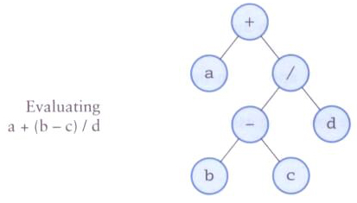
Expression Trees
The evaluation of a particular expression can be shown using an expression tree
The operators lower in the tree have higher precedence for that expression

Slide 34
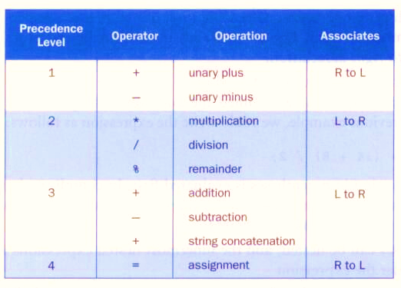
Operator Precedence
Precedence among some Java operators:

Slide 35
//********************************************************************
// TempConverter.java Java Foundations
//
// Demonstrates the use of primitive data types and arithmetic
// expressions.
//********************************************************************
public class TempConverter
{
//-----------------------------------------------------------------
// Computes the Fahrenheit equivalent of a specific Celsius
// value using the formula F = (9/5)C + 32.
//-----------------------------------------------------------------
public static void main (String[] args)
{
final int BASE = 32;
final double CONVERSION_FACTOR = 9.0 / 5.0;
double fahrenheitTemp;
int celsiusTemp = 24; // value to convert
fahrenheitTemp = celsiusTemp * CONVERSION_FACTOR + BASE;
System.out.println ("Celsius Temperature: " + celsiusTemp);
System.out.println ("Fahrenheit Equivalent: " + fahrenheitTemp);
}
}

Slide 36
Assignment Revisited
The assignment operator has a lower precedence than the arithmetic operators
First the expression on the right hand
side of the = operator is evaluated
answer = sum / 4 + MAX * lowest;
4
1
3
2
Then the result is stored in the
variable on the left hand side

Slide 37
Assignment Revisited
The right and left hand sides of an assignment statement can contain the same variable
First, one is added to the
original value of count
count = count + 1;
Then the result is stored back into count
(overwriting the original value)

Slide 38
Increment and Decrement Operators
The increment and decrement operators use only one operand
The increment operator (++) adds one to its operand
The decrement operator (--) subtracts one from its operand
The statement
count++;
is functionally equivalent to
count = count + 1;

Slide 39
Increment and Decrement Operators
The increment and decrement operators can be applied in postfix form
count++
or prefix form
++count
When used as part of a larger expression, the two forms can have different effects
Because of their subtleties, the increment and decrement operators should be used with care

Slide 40
Assignment Operators
Often we perform an operation on a variable, and then store the result back into that variable
Java provides assignment operators to simplify that process
For example, the statement
num += count;
is equivalent to
num = num + count;

Slide 41
Assignment Operators
There are many assignment operators in Java, including the following:
Operator
+=
-=
*=
/=
%=
Example
x += y
x -= y
x *= y
x /= y
x %= y
Equivalent To
x = x + y
x = x - y
x = x * y
x = x / y
x = x % y

Slide 42
Assignment Operators
The right hand side of an assignment operator can be a complex expression
The entire right-hand expression is evaluated first, then the result is combined with the original variable
Therefore
result /= (total-MIN) % num;
is equivalent to
result = result / ((total-MIN) % num);

Slide 43
Assignment Operators
The behavior of some assignment operators depends on the types of the operands
If the operands to the += operator are strings, the assignment operator performs string concatenation
The behavior of an assignment operator (+=) is always consistent with the behavior of the corresponding operator (+)

Slide 44
Data Conversions
Sometimes it is convenient to convert data from one type to another
For example, in a particular situation we may want to treat an integer as a floating point value
These conversions do not change the type of a variable or the value that's stored in it – they only convert a value as part of a computation

Slide 45
Data Conversions
Conversions must be handled carefully to avoid losing information
Widening conversions are safest because they tend to go from a small data type to a larger one (such as a short to an int)
Narrowing conversions can lose information because they tend to go from a large data type to a smaller one.
In Java, data conversions can occur in three ways
assignment conversion
promotion
casting

Slide 46
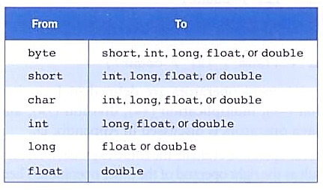
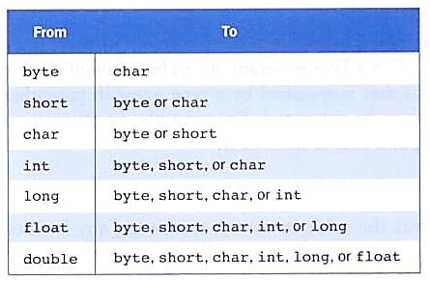
Data Conversions
Widening Conversions
Narrowing Conversions

Slide 47
Assignment Conversion
Assignment conversion occurs when a value of one type is assigned to a variable of another
If money is a float variable and dollars is an int variable, the following assignment converts the value in dollars to a float
money = dollars
Only widening conversions can happen via assignment
Note that the value or type of dollars did not change

Slide 48
Promotion
Promotion happens automatically when operators in expressions convert their operands
For example, if sum is a float and count is an int, the value of count is converted to a floating point value to perform the following calculation
result = sum / count;

Slide 49
Casting
Casting is the most powerful, and dangerous, technique for conversion
Both widening and narrowing conversions can be accomplished by explicitly casting a value
To cast, the type is put in parentheses in front of the value being converted
For example, if total and count are integers, but we want a floating point result when dividing them, we can cast total
result = (float) total / count;

Slide 50
The Scanner Class
The Scanner class provides convenient methods for reading input values of various types
A Scanner object can be set up to read input from various sources, including the user typing values on the keyboard
Keyboard input is represented by the System.in object
https://docs.oracle.com/javase/8/docs/api/java/util/Scanner.html

Slide 51
Reading Input
The following line creates a Scanner object that reads from the keyboard
Scanner scan = new Scanner(System.in);
The new operator creates the Scanner object
Once created, the Scanner object can be used to invoke various input methods, such as
answer = scan.nextLine();

Slide 52
Reading Input
The Scanner class is part of the java.util class library, and must be imported into a program to be used
The nextLine method reads all of the input until the end of the line is found
We'll discuss the details of object creation and class libraries later

Slide 53
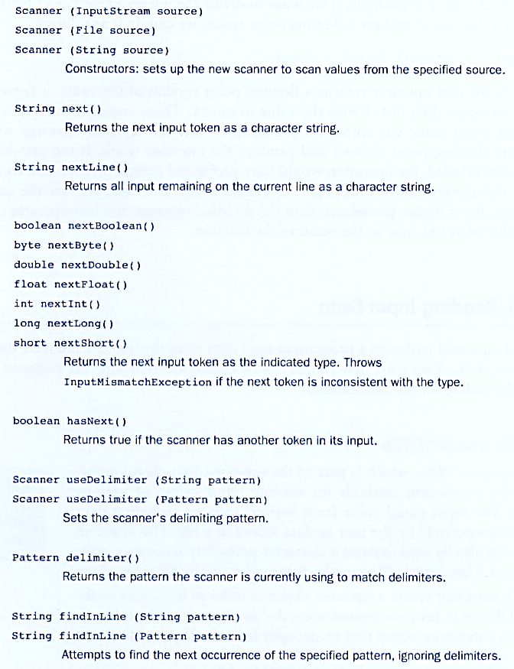
xxx
Some methods of the Scanner class:

Slide 54
//********************************************************************
// Echo.java Java Foundations
//
// Demonstrates the use of the nextLine method of the Scanner class
// to read a string from the user.
//********************************************************************
import java.util.Scanner;
public class Echo
{
//-----------------------------------------------------------------
// Reads a character string from the user and prints it.
//-----------------------------------------------------------------
public static void main(String[] args)
{
String message;
Scanner scan = new Scanner(System.in);
System.out.println("Enter a line of text:");
message = scan.nextLine();
System.out.println("You entered: \"" + message + "\"");
}
}

Slide 55
Input Tokens
Unless specified otherwise, white space is used to separate the elements (called tokens) of the input
White space includes space characters, tabs, new line characters
The next method of the Scanner class reads the next input token and returns it as a string
Methods such as nextInt and nextDouble read data of particular types

Slide 56
//********************************************************************
// GasMileage.java Java Foundations
//
// Demonstrates the use of the Scanner class to read numeric data.
//********************************************************************
import java.util.Scanner;
public class GasMileage
{
//-----------------------------------------------------------------
// Calculates fuel efficiency based on values entered by the
// user.
//-----------------------------------------------------------------
public static void main(String[] args)
{
int miles;
double gallons, mpg;
Scanner scan = new Scanner(System.in);
System.out.print("Enter the number of miles: ");
miles = scan.nextInt();
System.out.print("Enter the gallons of fuel used: ");
gallons = scan.nextDouble();
mpg = miles / gallons;
System.out.println("Miles Per Gallon: " + mpg);
}
}

